Slide 1
Final Assignment
Philip V. Brodersen, Simon C. Dockweiler, and Rasmus Gjerlund

Slide 2
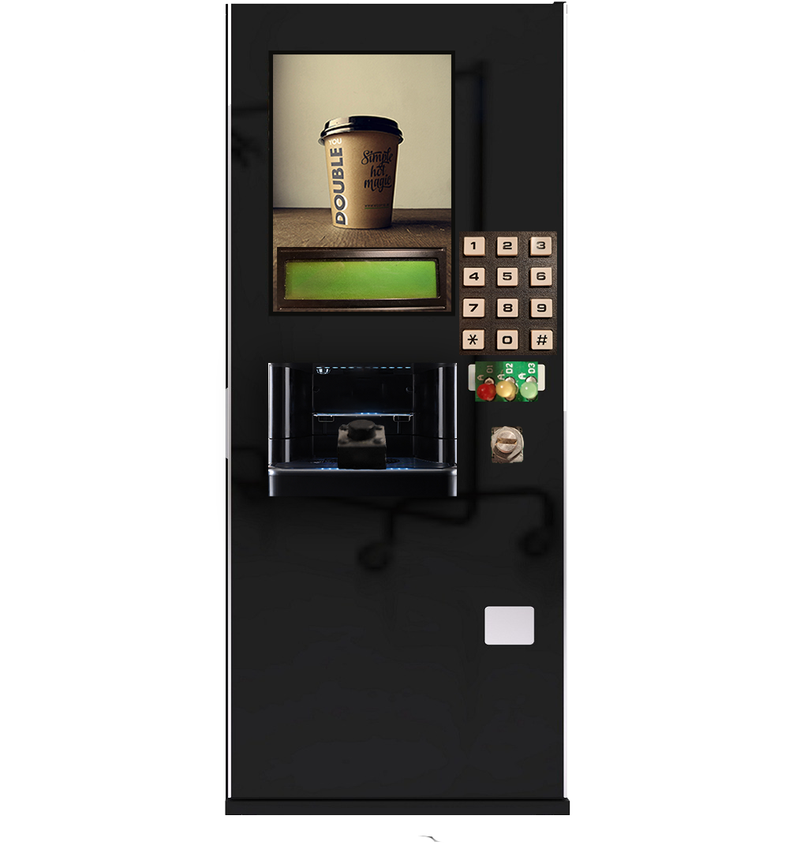
Contents
Task diagram
Queues
Semaphores
FSM
Payment
Coffee
FreeRTOS
DEMO

Slide 3
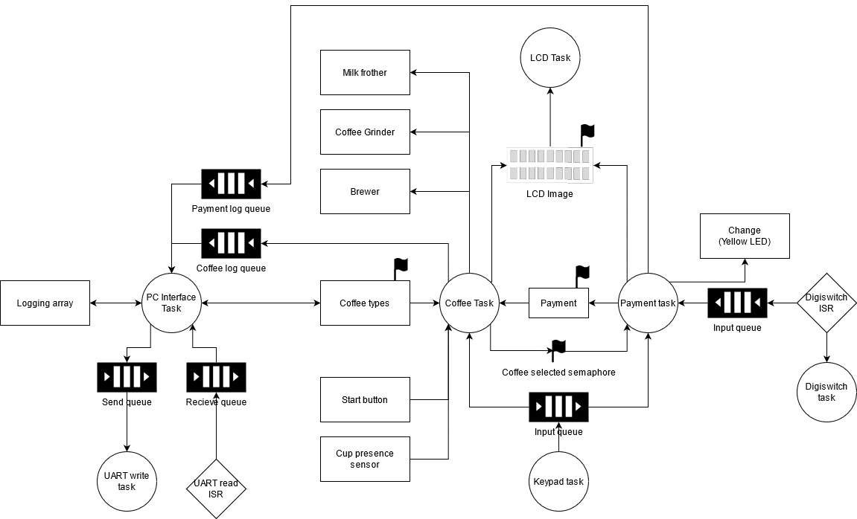
Task diagram

Slide 4
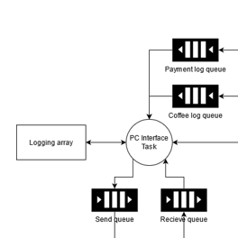
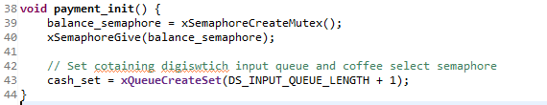
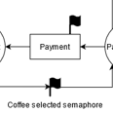
Task diagram
Queues
Purpose
Functionality
Semaphores
Purpose
Functionality

Slide 5
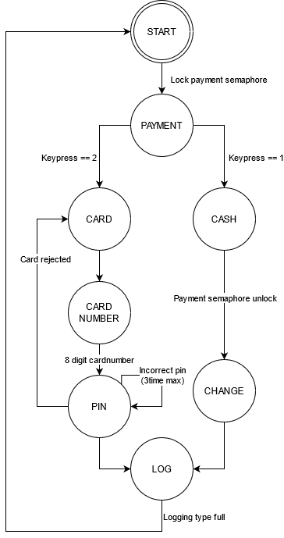
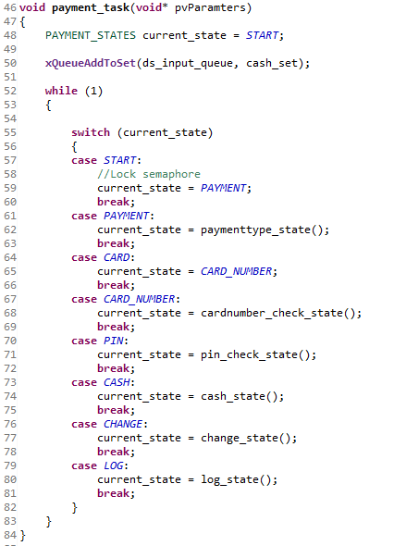
FSM
Payment
State machine
Implementation

Slide 6
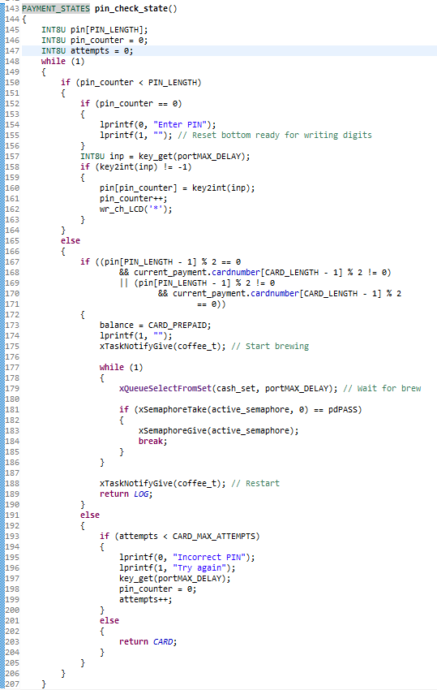
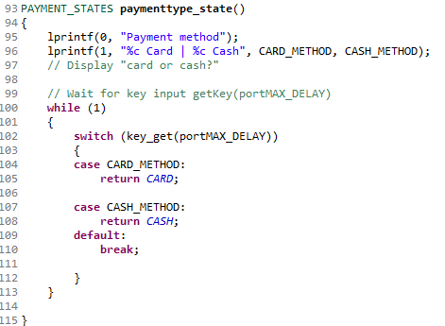
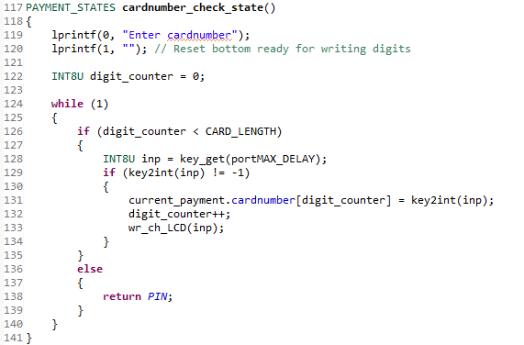
FSM
Payment
State logic
Card

Slide 7
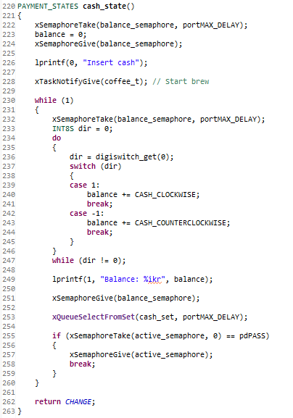
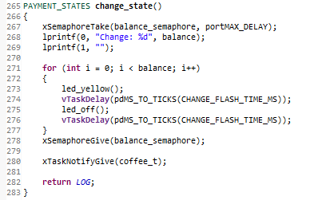
FSM
Payment
State logic
Cash

Slide 8
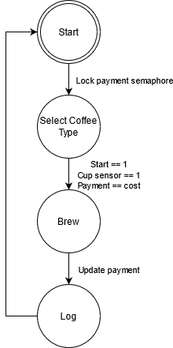
FSM
Coffee
State machine
Implementation

Slide 9
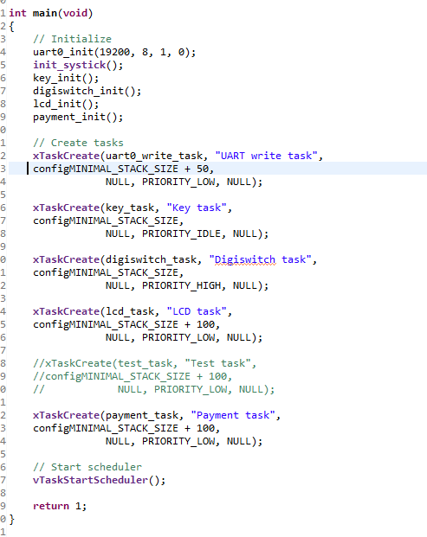
FreeRTOS
Code
Task creation

Slide 10
DEMO

